Slide 1
Coding and Coffee: An Intro to Version Control and GitHub
January 20, 2022

Slide 2
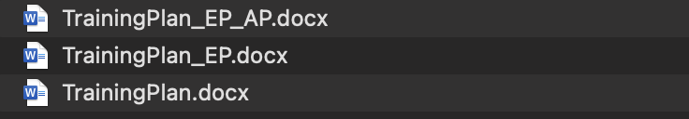
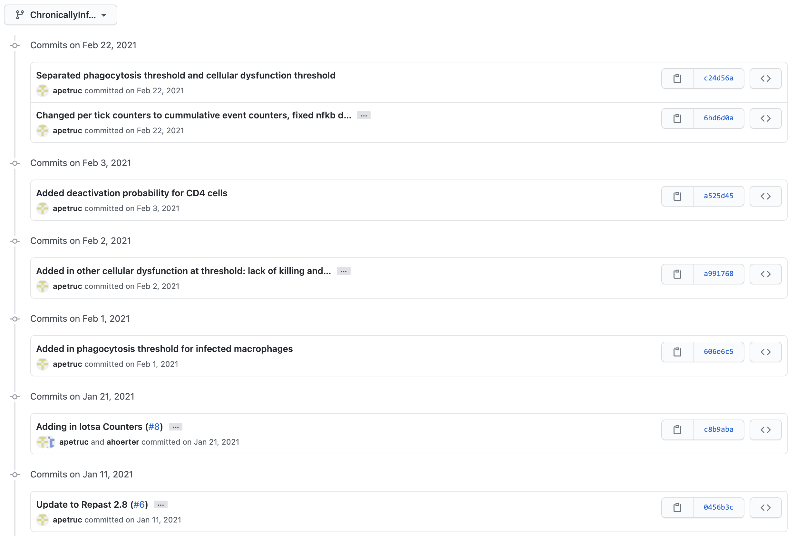
Version control
Track your changes
Debugging
Collaboration
Documentation
Backups
Testing

Slide 3
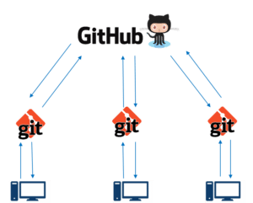

GitHub
Remote Repository
Version Control Tool
Repository = Project
Commit = Version
Branches
Local Repository
https://www.c-sharpcorner.com/article/git-and-github-version-control-local-and-remote-repository/
https://www.nobledesktop.com/learn/git/git-branches

Slide 4
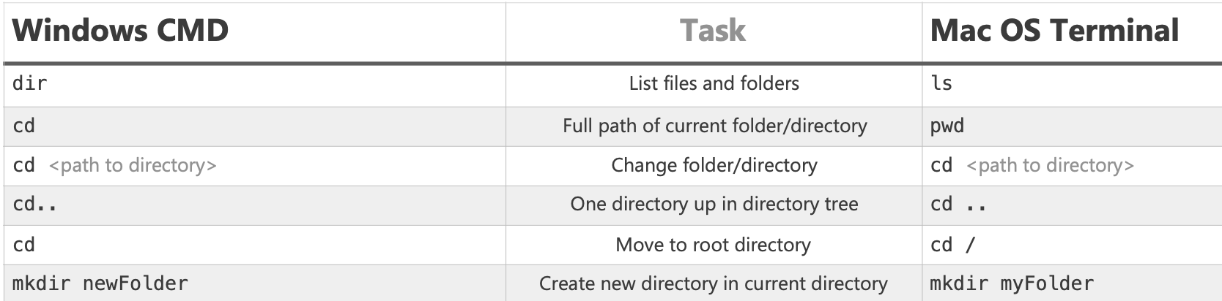
Getting started
Download git
https://git-scm.com/download/win
Log on
https://github.itap.purdue.edu/
Open Terminal/Command Window
Navigate to folder
Clone repository
https://github.itap.purdue.edu/apetruc/bagel-order.git
https://enexdi.sciencesconf.org/data/pages/windows_vs_mac_commands_1.pdf

Slide 5
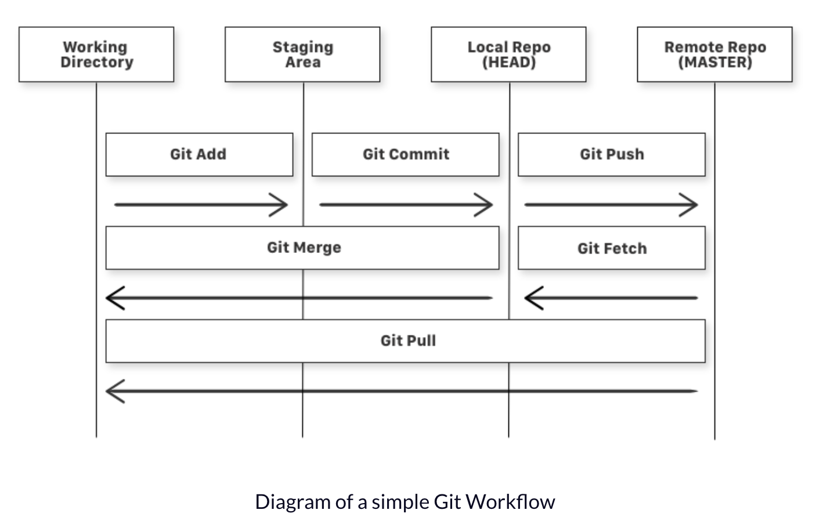
Common commands
git status
git add (-A)
git commit -m “Message”
git push
git pull
git checkout –b NAME
https://www.freecodecamp.org/news/learn-the-basics-of-git-in-under-10-minutes-da548267cc91/

Slide 6
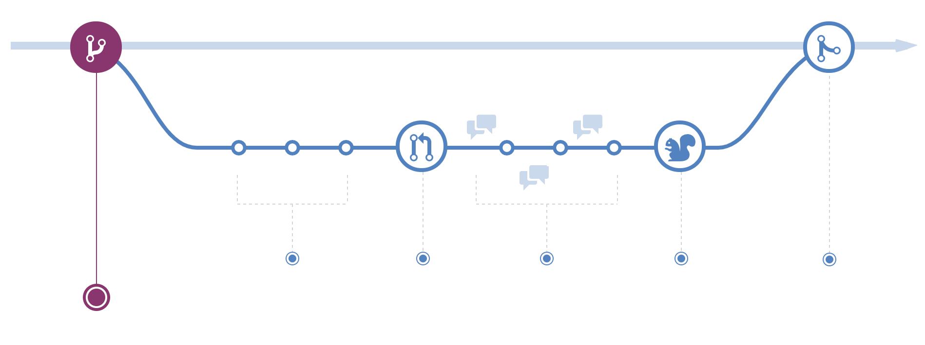
Current Workflow: Make new branch
https://guides.github.com/introduction/flow/

Slide 7
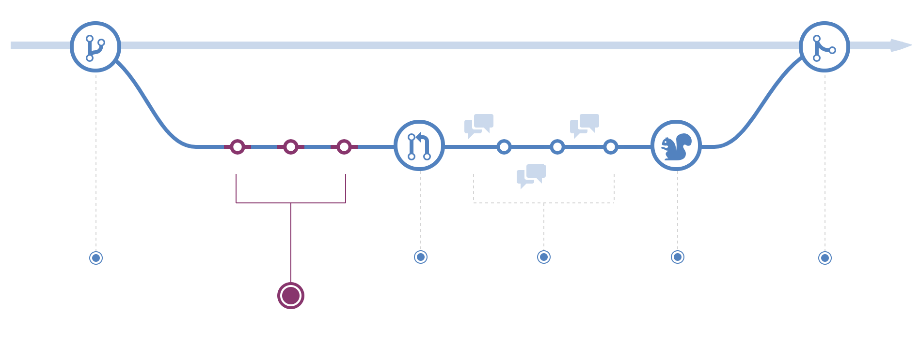
Current Workflow: Commit changes
https://guides.github.com/introduction/flow/

Slide 8

Current Workflow: Open pull request (PR)
https://guides.github.com/introduction/flow/

Slide 9
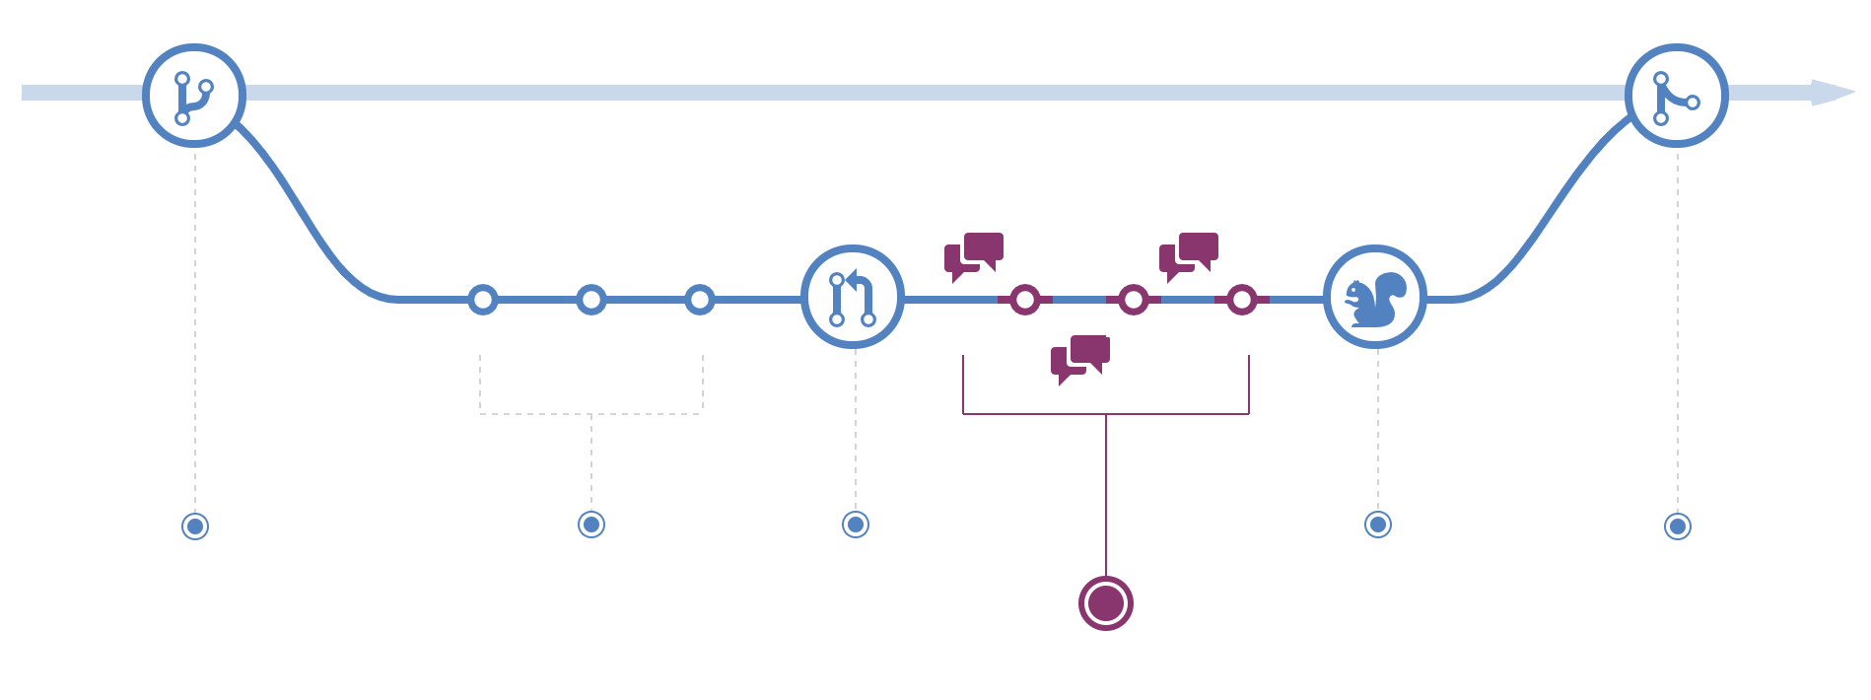
Current Workflow: Discuss/review code
https://guides.github.com/introduction/flow/

Slide 10
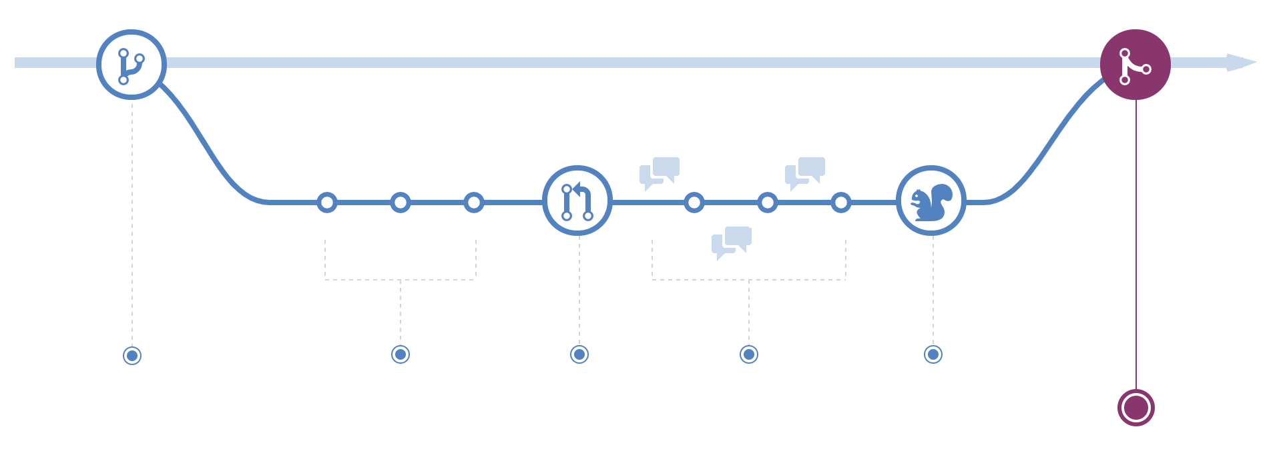
Current Workflow: Merge back into master/main
https://guides.github.com/introduction/flow/

Slide 11
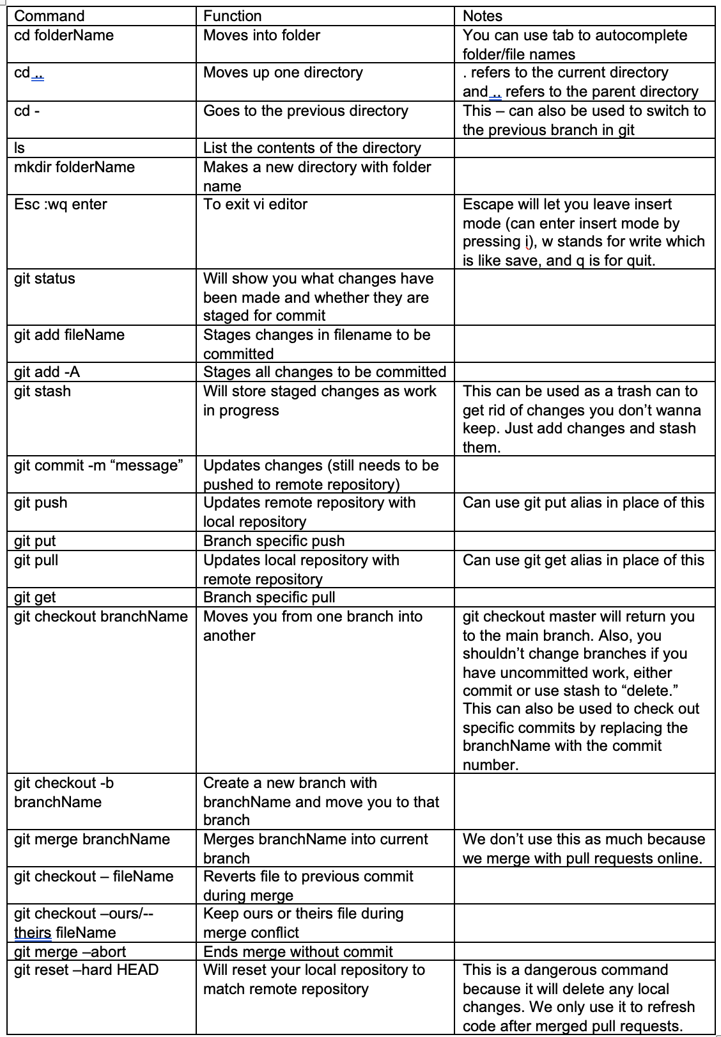
Activity!
Clone repository
https://github.itap.purdue.edu/apetruc/bagel-order.git
Make new branch
Edit README file to add your bagel/smear/drink order
Open pull request
Request comment on code
Merge into main

Slide 12
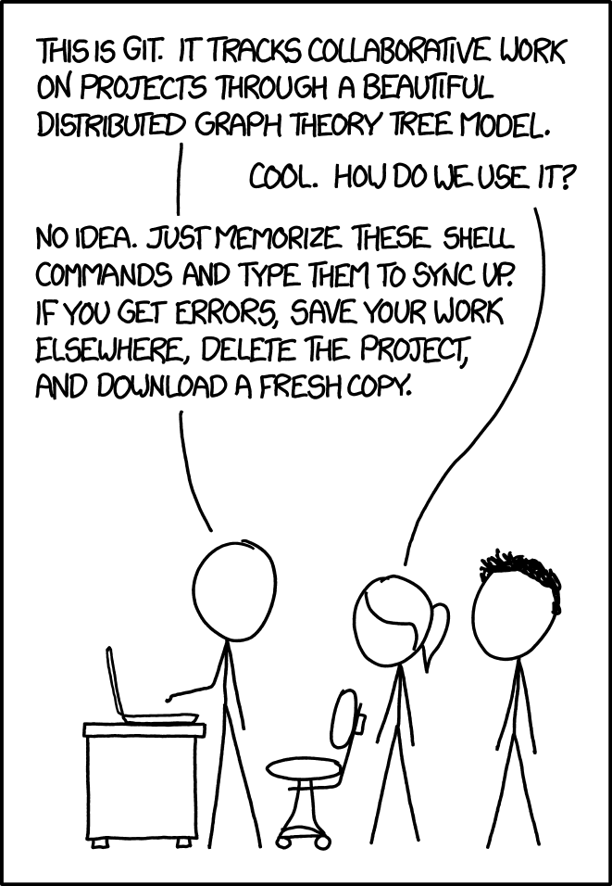
Best Practices
Commit often
Test code before you commit
Write detailed commit messages
Use branches – especially when collaborating
xkcd.com
DON’T BE AFRAID TO ASK FOR HELP OR GOOGLE THINGS!

Slide 13
References
https://github.com/git-guides/install-git
https://docs.github.com/en/get-started/quickstart/hello-world
https://www.freecodecamp.org/news/learn-the-basics-of-git-in-under-10-minutes-da548267cc91/
https://guides.github.com/introduction/flow/
https://www.c-sharpcorner.com/article/git-and-github-version-control-local-and-remote-repository/
https://www.nobledesktop.com/learn/git/git-branches

